Slide 1
Embrace Observability
Timothy Mahoney
Ingka Group Digital (IKEA)
Splunk Observability Week 2023

Slide 2
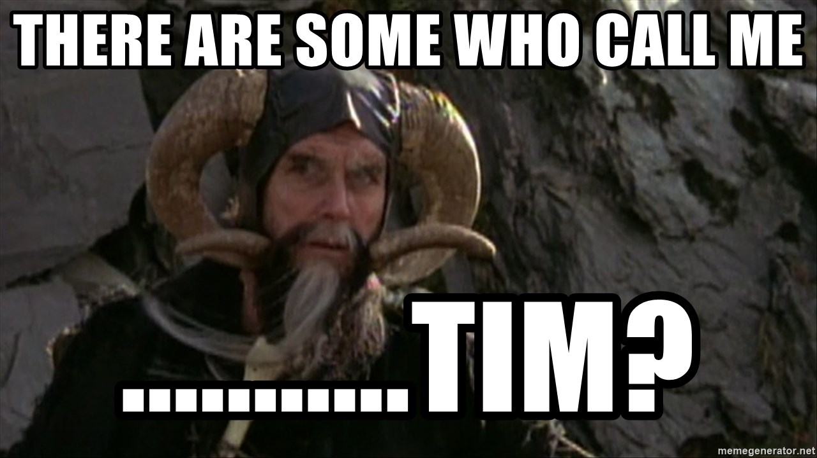
About Me
Timothy Mahoney
American living in Sweden
Former Satellite Network Engineer
Volunteer Arbiter with RIPE NCC
Vim user
Really into obfuscated Awk

Slide 3
What I do
Senior Systems Engineer in the Observability Pipeline Team
Observability Framework
OpenTelemetry and OpenTelemetry Collector
Documentation, Examples, Demos, Labs, Tests
INGKA Native Clouders program training lab on O11y and Distributed Tracing

Slide 4
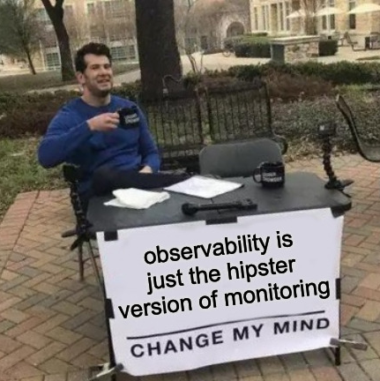
What are we even talking about?
Notes:
Talk about starting out in Log Analytics
Set the stage for discussing your journey into o11y and sre

Slide 5
O11y in the IT systems context
IT Operational Observability Signals
The overused "Three Pillars of Observability"
Different types of systems use different types of observability.

Slide 6
Metrics
Notes:
Where we started:
Proprietary metrics in application monitor and control suites.
Metrics field extracted from log data.
Where we are going:
Metrics as a telemetry data type

Slide 7
Metrics should be...
Notes:
LOW cardinality data
Gauge
Delta
Histogram
Can have Labels
Can have exemplars
Adding cardinality to metrics data increases the size and cost of the timeseries db that stores metrics.

Slide 8
Logs
Notes:
"Check the logs"
Format is often dictated by 3rd party vendors, haphazardly structured or both.
Cleanup with props, transforms, schema on the fly
Responsibility to turn log events into useful data lies with the tooling.

Slide 9
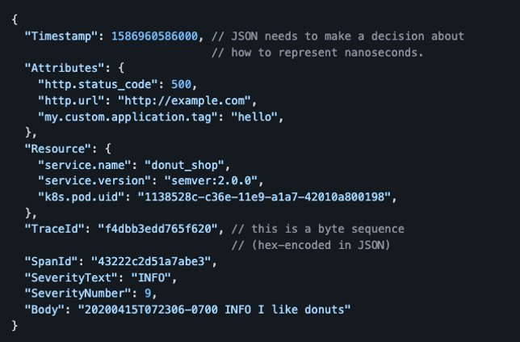
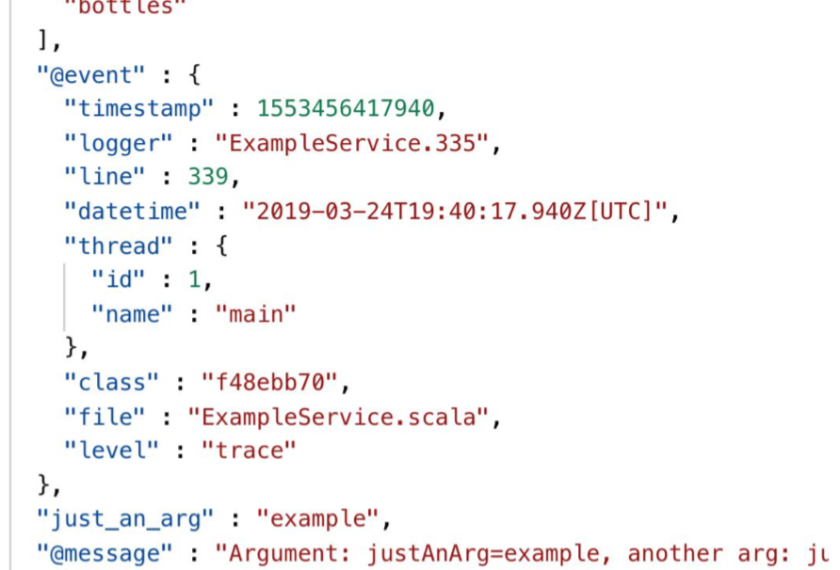
Making logs great again:
Notes:
Structured Events
Arbitrarily Wide Events
JSON or ProtoBuf
Event driven architecture, application does its thing and emits an event.
It as though devs read our minds! Structure your data!

Slide 10
Pitfalls of logging
Notes:
Printf()
Format? Context? Correlation?

Slide 11
Traditional logs require skilled correlation.

Slide 12
Notes:
With distributed applications and microservices, how can we find where our application is spending the most time and where it is failing?

Slide 13
Enter distributed tracing

Slide 14
Tracing a distributed application.

Slide 15
"We're just going to turn the logs off..."

Slide 16
Trace propagation, message queues and databases.

Slide 17
Tracing for CI/CD Pipelines

Slide 18
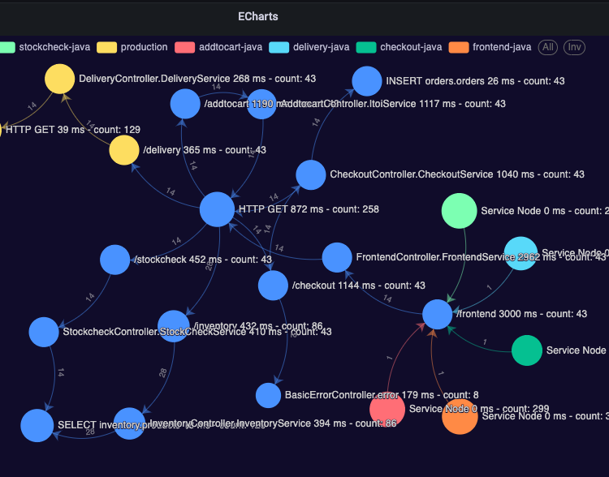
Using traces to map services
Notes:
Trace baggage can include key value pairs to map to services, shopping carts, users, to spans.
Trace data can be used to map a system "as-built"
Many teams have no clue who their consumers are

Slide 19
Correlation between signals
Notes:
Exemplars, span metrics, trace id in logs
Good observability means good correlation
No longer trying to find timestamps and hostnames

Slide 20
OpenTelemetry
Notes:
This changes everything
Open Source CNCF Project
Standard for Telemetry Data
Widely adopted
OTLP Transport Specification

Slide 21
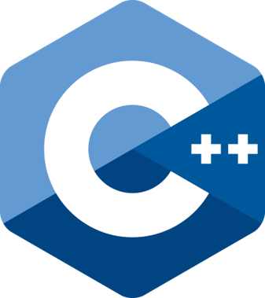
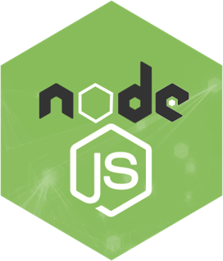
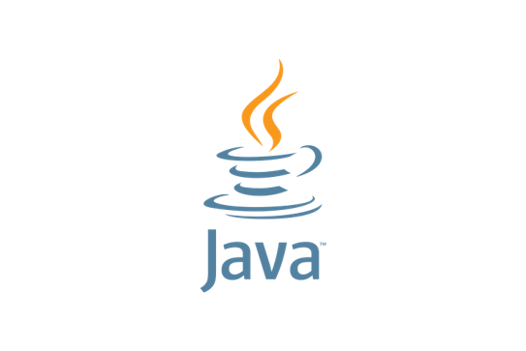
Instrumentation
Notes:
SDKs, Instrumentation Libraries, Auto Instrumentation
Contrib inputs from b3 zipkin, Prometheus, etc

Slide 22
Cloud and Vendor Agnostic
Notes:
Instrument once, consume anywhere.
Use the same instrumentation for your application in different environments.
Run the same code in Azure, GCP, AliCloud with the same instrumentation and only change the collector config to suit your needs.

Slide 23
The OpenTelemetry Collector

Slide 24
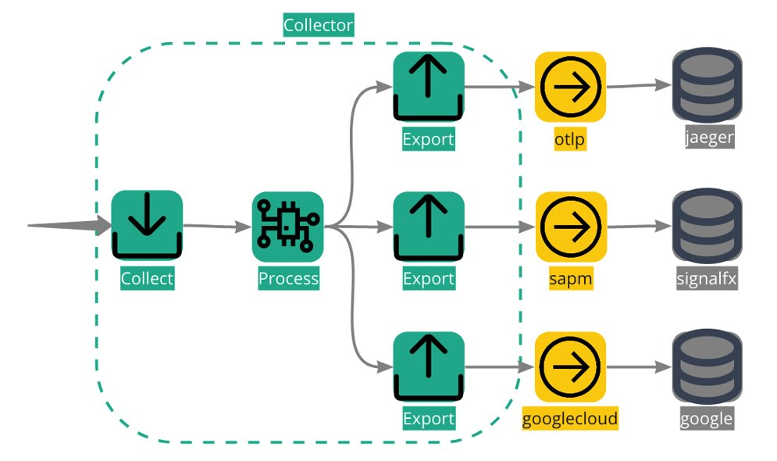
Collector Contrib and Fan Out

Slide 25
Telemetry Sinks
Notes:
Splunk, Splunk Observability, Mimir, Tempo, Loki, Google Cloud, Cloud Buckets, Jaeger

Slide 26
Observability vs Monitoring
Notes:
Monitor for known unknowns, observability is about asking arbitrary questions, finding unknown unknowns.

Slide 27
I will admit to listening to way too much O11ycast.

Slide 28
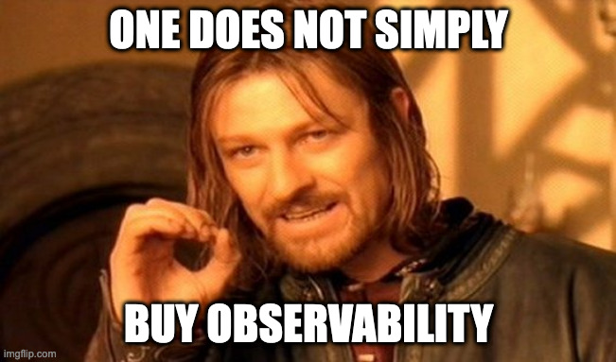
Observability is not the tooling.

Slide 29
Observability costs money
”It should be a NFR of any project”
Notes:
It's should be part of any service budget.
It takes time to instrument code.
It should be a NFR of any project.
You can easily defend the cost of your observability data if you are actively using it and getting value from

Slide 30
Common Challenges in Observability
Write once, read never database
Tools as a junk drawer
Those "I need ALL the data" people
Dashboards as technical debt
"You build it, you run it" team decides to run own observability stack
"What do you mean this isn't a debugging tool?"
Trying to solve data or business observability issues using only application telemetry.

Slide 31
Site Reliability Engineering
Created by Google
SRE book is freely available

Slide 32
Service Level Agreements Service Level Objectives Service Level Indicators

Slide 33
Where do we even begin?
What metrics can we use to describe the critical aspects of our service?
Where is the best place to measure them?
Who is using this service?
What are our Service Level Indicators?
Notes:
Metrics:
Delta or Cumulative for Request Based SLI
Delta, Cumulative or Gauge for Windowed SLI
Not high cardinality
Linear measurement of user happiness. Percentage

Slide 34
So how is using metrics for SLOs different than just monitoring?
Notes:
We don't want to analyze metrics for every aspect of our service.
We don't need to create a bunch of special rules and tests based on one-off scenarios.
We are only interested in the metrics that make our users happy.
Happy Users Happy Engineers

Slide 35
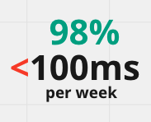
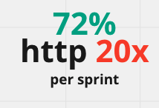
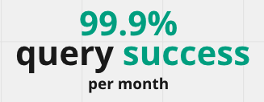
Request based SLIs
Notes:
Measured counting atomic units of service. Overall performance, but low granularity.

Slide 36
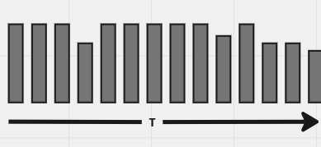
Windows-based SLIs
Notes:
Group performance by time windows and count good vs bad windows.
95% http 20x responses per 1 minute window
P95 latency metric less than 100ms per 5 minute window

Slide 37
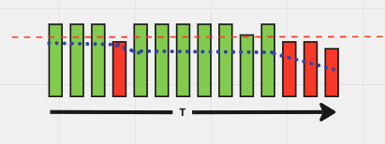
Error Budgets
Notes:
Maximum amount of time a technical system can fail without contractual consequences.
A measurement of the difference between actual and desired performance.
When are users unhappy, when do people notice?

Slide 38
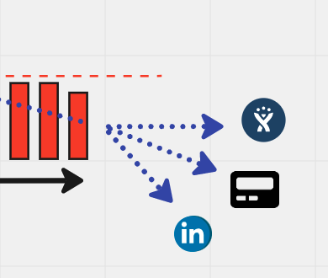
Burn Rate
Notes:
The rate at which the error budget is consumed.
Make your alerting decisions based on your burn rate.
Clear indication if a problem needs immediate attention, if it can wait until morning or if it needs to be addressed in the next sprint.

Slide 39
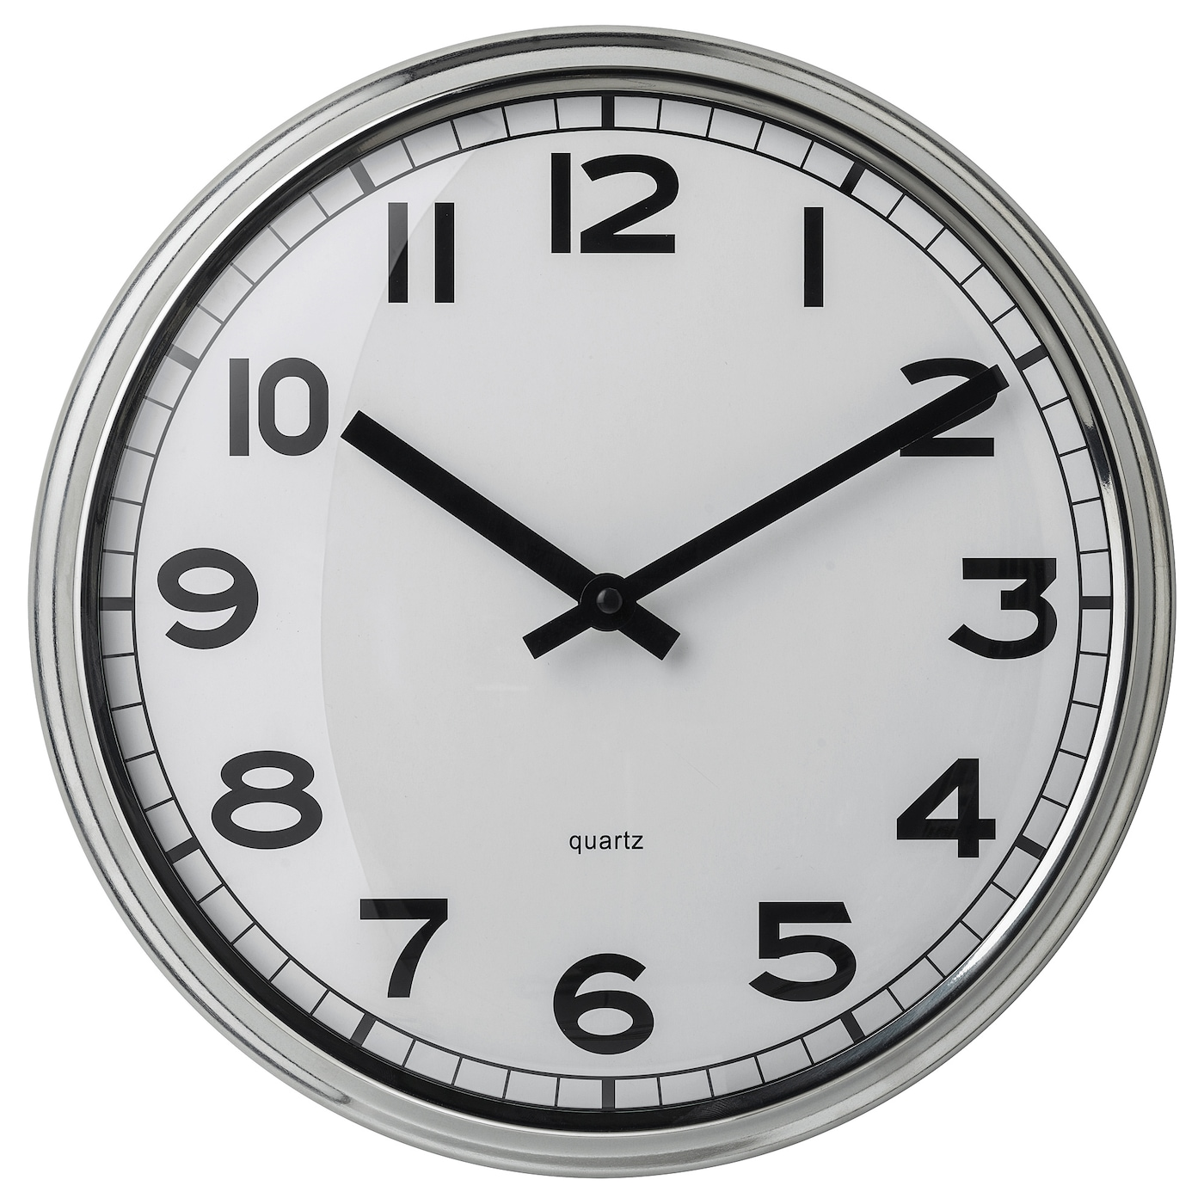
It all comes down to time.
Notes:
When describing the reliability of a service, the key denominator is time. Requests over time, errors over time, latency over time.
Time:
Hours for alerting
Weeks for tactical decisions
Months for strategic decisions

Slide 40
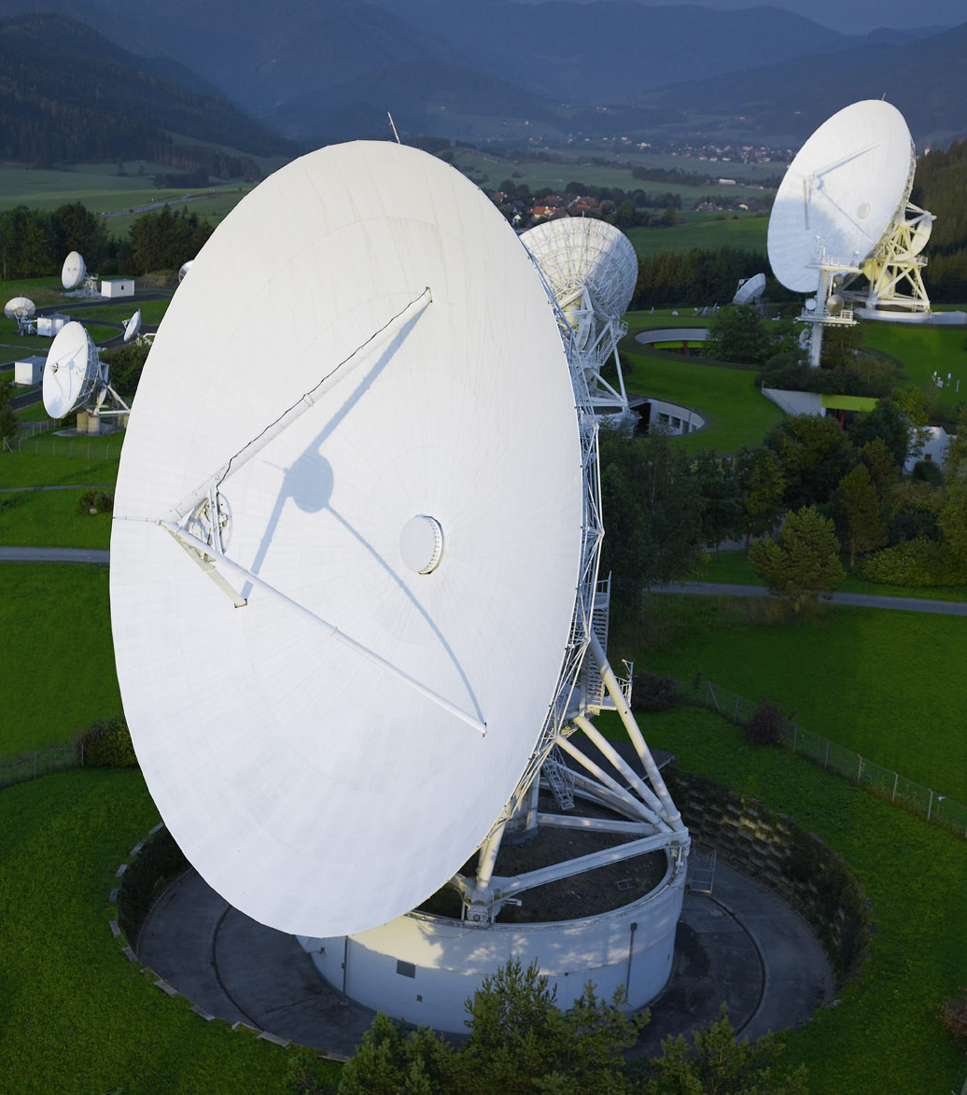
Availability and the mythical nine nines
Available minutes / total minutes
Notes:
Fundamental layers set the limits of your reliability. You can't have 99.999% reliability on a 99.9% reliable network with a 98% reliable database. The cost and resource requirements of additional nines is exponential.

Slide 41
Appropriate Reliability
Notes:
What is reasonable for our service?
What timeframe?
How is our service being used?
How many resources are we willing to commit to ensure higher reliability?
Can we get eyes on a problem in time?

Slide 42
Service Level Agreements
Notes:
The "do not cross" line.
SLA should always be lower than your SLO.
If you don't have an SLA, consider setting SLOs first as a test of what is possible.
Bust your SLA and the fun police get involved.

Slide 43
The role of a SLO
Soft limit
Performance expectation
Not a fixed contract
Meant to be revised, reviewed, updated.
Do you engineer for perfection, or do you set reasonable expectations?

Slide 44
SLOs in the wild
Notes:
Share your SLIs and SLOs to create a reasonable expectation of service level for your consumers.
Choose a synchronous or asynchronous means of sending data to an API based on latency and peak request SLIs.
Communicate service issues to stakeholders.
Allow teams to understand service issues without having deep technical knowledge of your service or share all your telemetry.

Slide 45
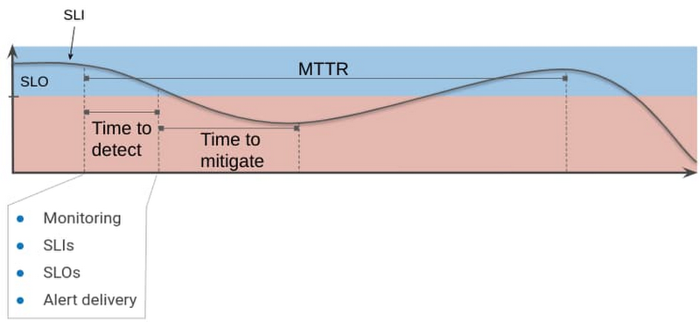
But my service is feature driven...
SLOs are your acceptable level of risk
Notes:
SLO can be thought of as acceptable level of risk.
SLOs can be an integral part of your DORA metrics.

Slide 46
Is it good enough?

Slide 47
Comparing SLOs to ITSI

Slide 48
Philosophical Differences
Free vs Proprietary
Decentralized vs Centralized
Clear boundaries between business and operational data
Tool agnostic vs Splunk specific
Integral component driving discussion between engineers, EM and PO

Slide 49
Design Differences
Measure as close as possible to consumer vs weighted service decomp
SLO data can be collected by APIs*
SLIs vs KPIs
Metrics consumed where they are produced vs single source of truth
DORA metrics vs Event Analytics*
Notes:
* Out of the box

Slide 50
Thoughts?
Are you adopting SRE?
Is anyone mixing SRE and ITSI in production?
Would SLI or SLO data be of any use as a KPI in ITSI?
Is anyone using trace propagation data to create service maps in Splunk?

Slide 51
Thank you
Special thanks to Splunk, Magnus Lord, Thomas Hille and my colleagues in the Observability Pipeline Team
timothy.mahoney1@ingka.ikea.com

