Slide 1
O11y vs Monitoring
What we talk about when we talk about Observability
Timothy Mahoney
Stockholm Splunk Users Group
January 19, 2023

Slide 2
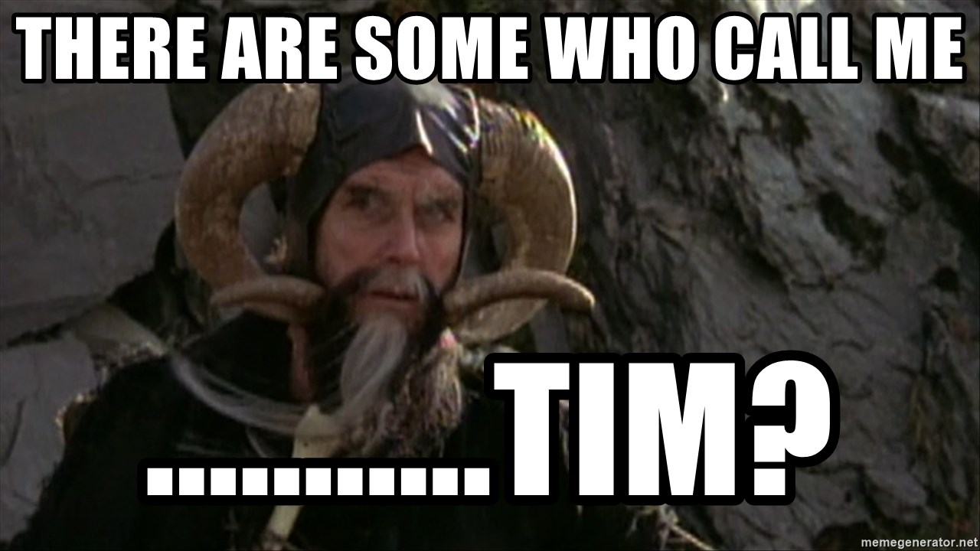
Who am I?
Timothy Mahoney
Senior Systems Engineer at Swedish furniture company you've probably never heard of..
Splunk Derp Gun co-presenter
Volunteer Arbiter for RIPE
Former Satellite Engineer

Slide 3
What I do
Senior Systems Engineer in the Observability Pipeline Team
Observability Framework
OpenTelemetry and OpenTelemetry Collector
Documentation, Examples, Demos, Labs, Tests
INGKA Native Clouders program training lab on O11y and Distributed Tracing

Slide 4
What are we even talking about?

Slide 5
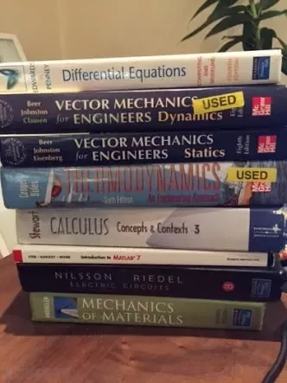
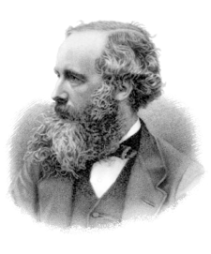
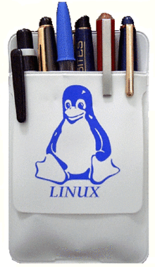
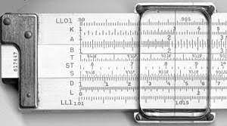
Control Theory
Control Theory revolves around systems
Observability in the control theory context is a generalization
Observability is gaining internal insight into a system from its external signals

Slide 6
O11y in the IT systems context
IT Operational Observability Signals
The overused "Three Pillars of Observability"
Different types of systems use different types of observability.

Slide 7
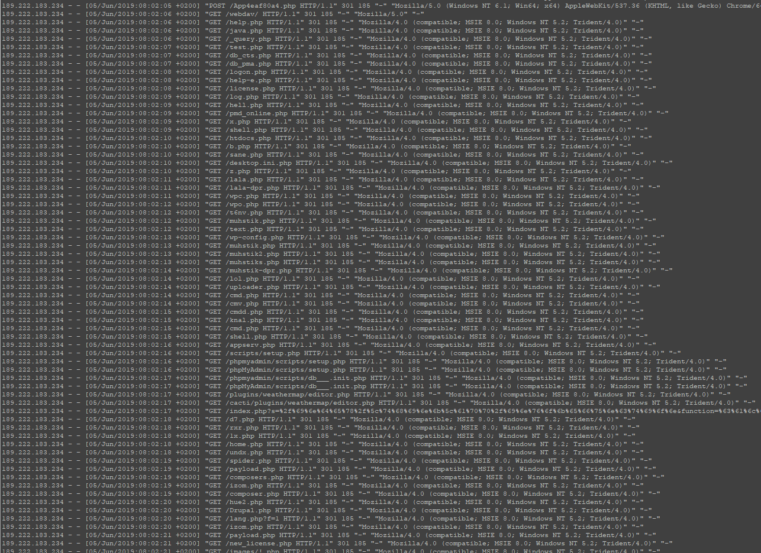
It all begins with logs..
"Check the logs"
Format is often dictated by 3rd party vendors, haphazardly structured or both.
Cleanup with props, transforms, schema on the fly
Responsibility to turn log events into useful data lies with the tooling.

Slide 8
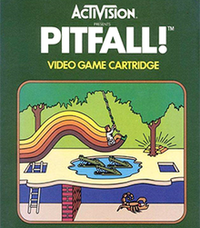
The pitfalls of printf()
Devs use printf() to write logs
Common practice
Syslog or stdout
Format? Context? Correlation?

Slide 9
Observability in the age of Microservices
Dev/Ops
Stateful and Stateless Workloads
Containerized workloads
CI/CD
Microservices trade the simplicity of the application for the complexity of the system.

Slide 10
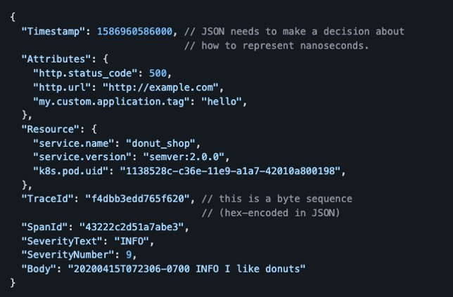
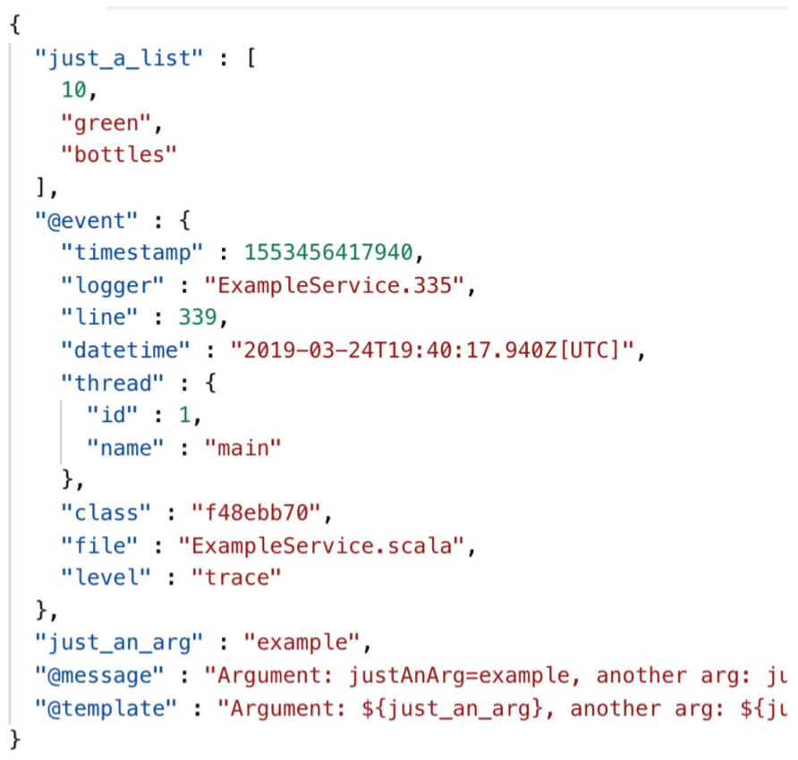
Making logs great again:
Structured Events
Arbitrarily Wide Events
JSON or ProtoBuf
Event driven architecture, application does its thing and emits an event.
It as though devs read our minds! Structure your data!

Slide 12
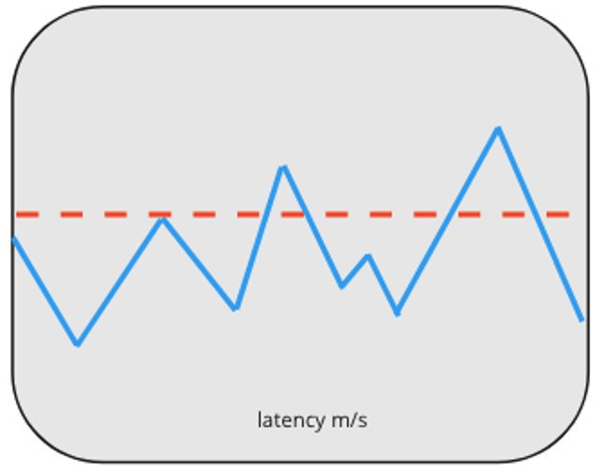
Metrics
Where we started:
Proprietary metrics in application monitor and control suites.
Metrics field extracted from log data.
Where we are going:
Metrics as a telemetry data type

Slide 13
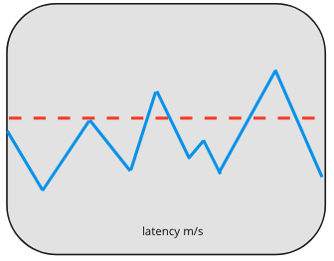
Metrics should be...
LOW cardinality data
Gauge
Delta
Histogram
Can have Labels
Can have exemplars
Adding cardinality to metrics data increases the size and cost of the timeseries db that stores metrics.

Slide 15
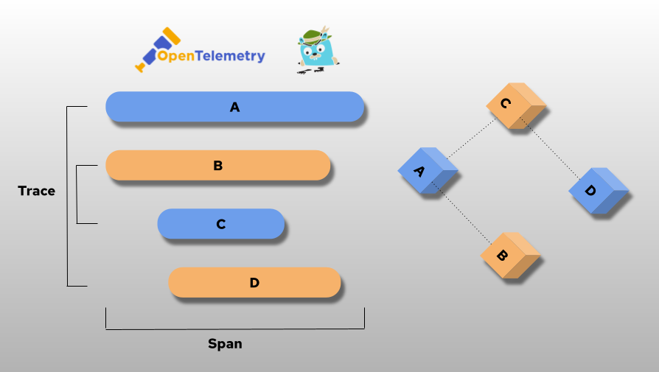
Traces
With distributed applications and microservices, how can we find where our application is spending the most time and where it is failing?

Slide 16
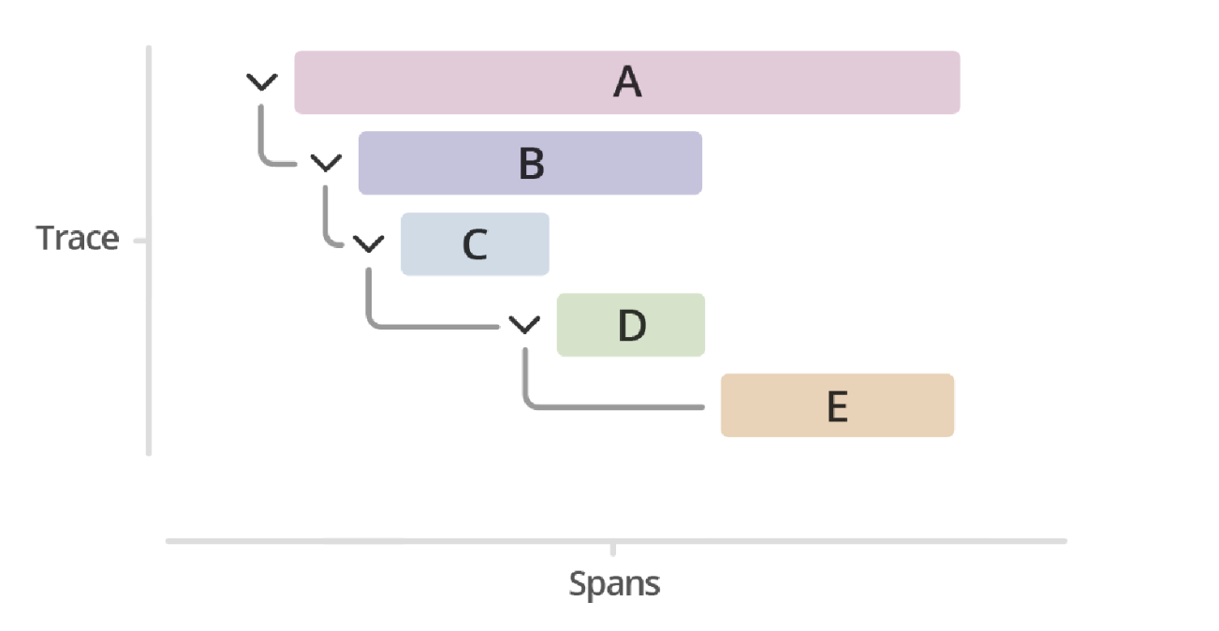
How do traces work?
Traces inherit a Trace ID from the Root Span (A)
Traces propagate the Trace ID on to all child spans(B,C,D,E)
If a request is received without any trace information, a new Trace ID is created.
The trace propagation is not limited by system.

Slide 17
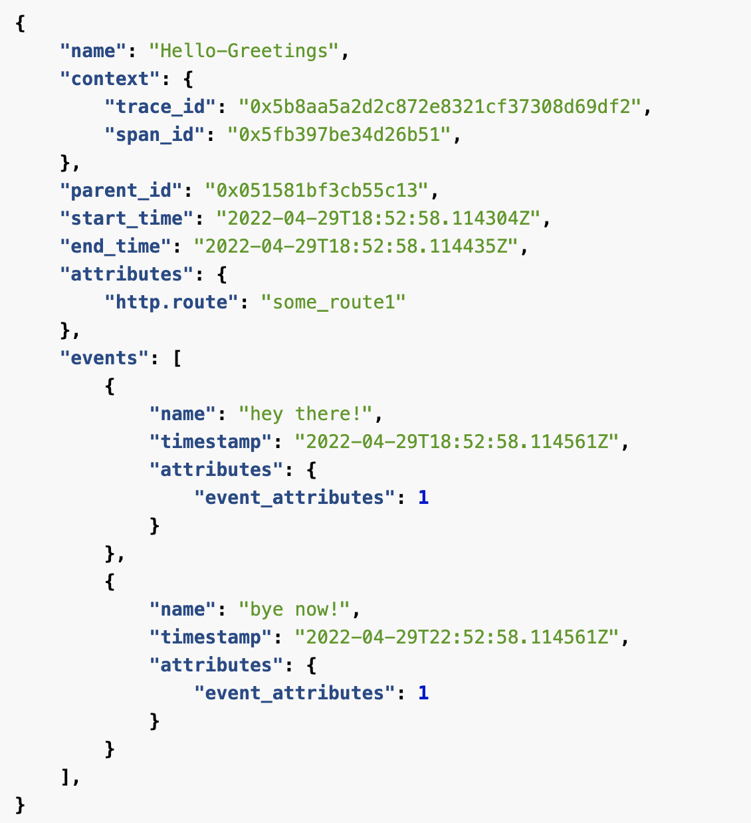
What do traces look like?
Important components:
Span Context – serialized and propagated, immutable
Attributes – key-value pair metadata
Events – structured log message
Span Links – Link multiple or async spans
Span Status – OK, Unset, Error
Span Kind – server, client, internal, producer, consumer

Slide 18
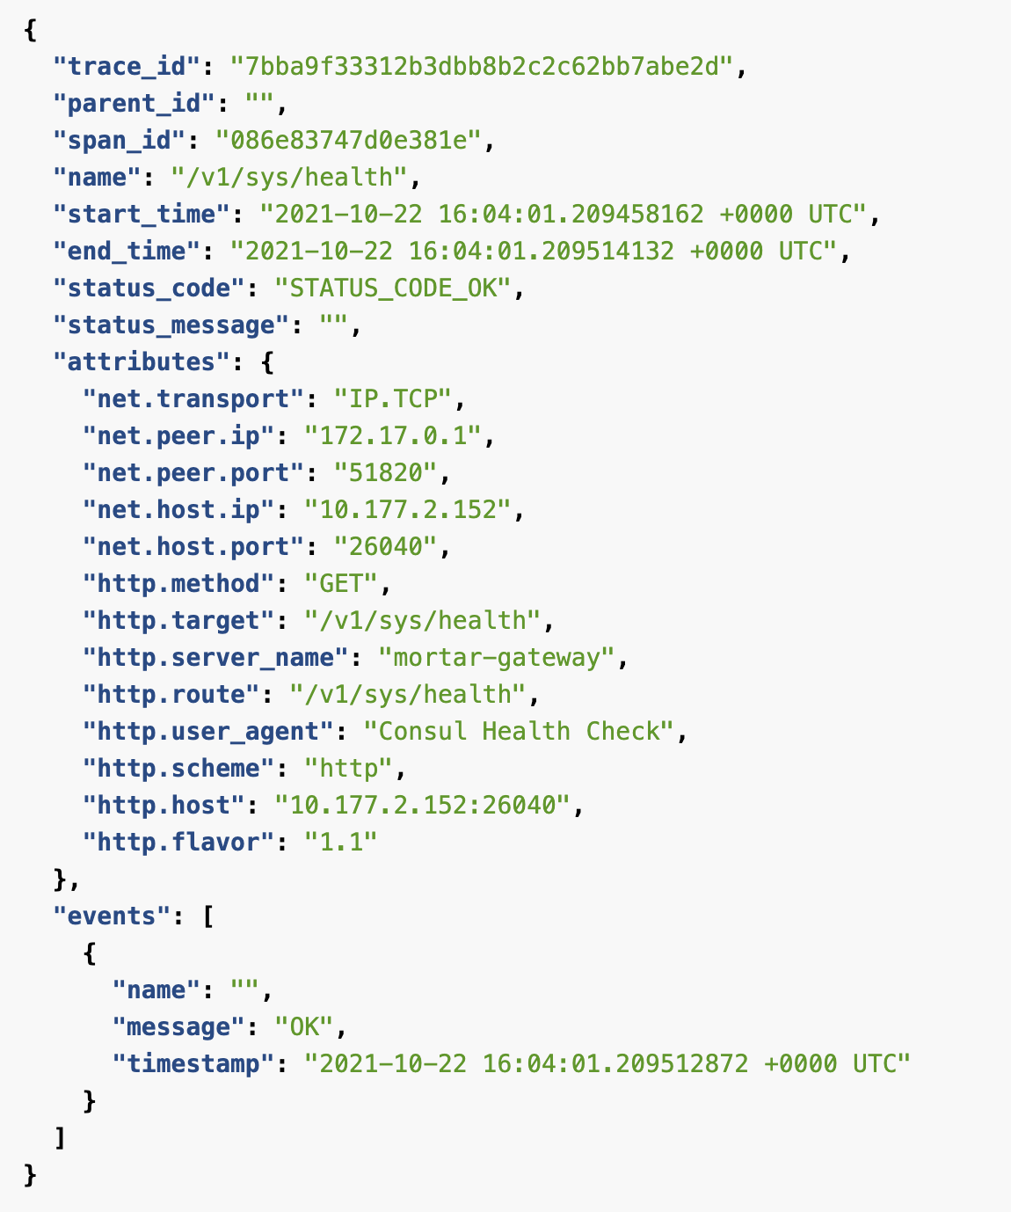
What is a span?
Span Metadata:
Service
Operation
Span ID
Parent ID
Time (Start – End)
Duration
Relative Start

Slide 19
"We're just going to turn the logs off..."
You're going to what?
Span Events

Slide 20
Trace propagation, message queues and databases.
Context propagation in PubSub messages
Context propagation in SQL message fields

Slide 21
Tracing for CI/CD Pipelines
Trace a build process
Why does a build take so long?
What is delaying our deployment?

Slide 23
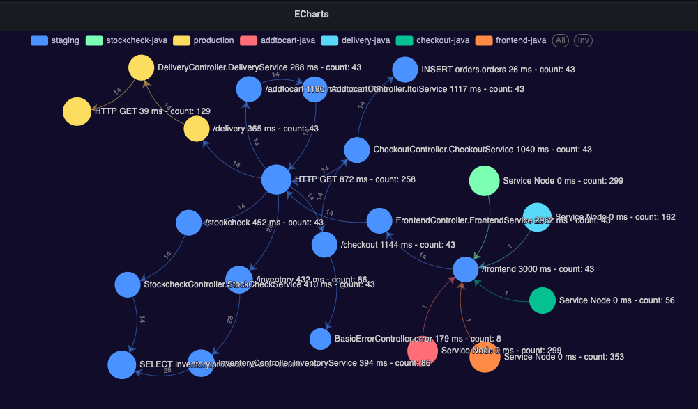
Using traces to map services
Trace baggage can include key value pairs to map to services, shopping carts, users, to spans.
Trace data can be used to map a system "as-built"
Many teams have no clue who their consumers are

Slide 24
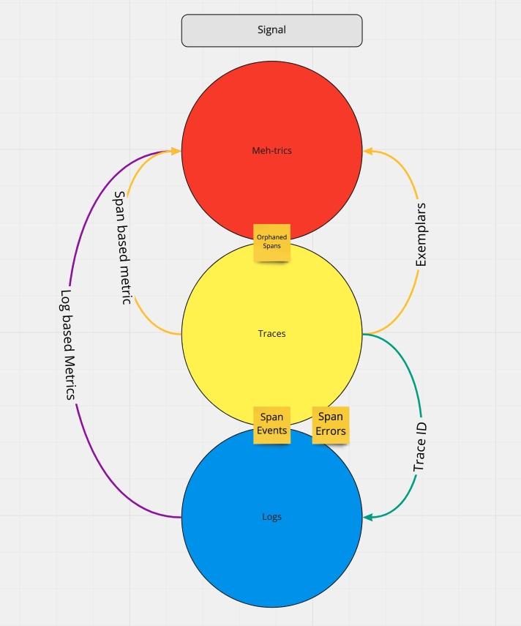
Correlating Signals
Log based Metrics
TraceID in Logs
Span Events
Orphaned Spans
Exemplars

Slide 25
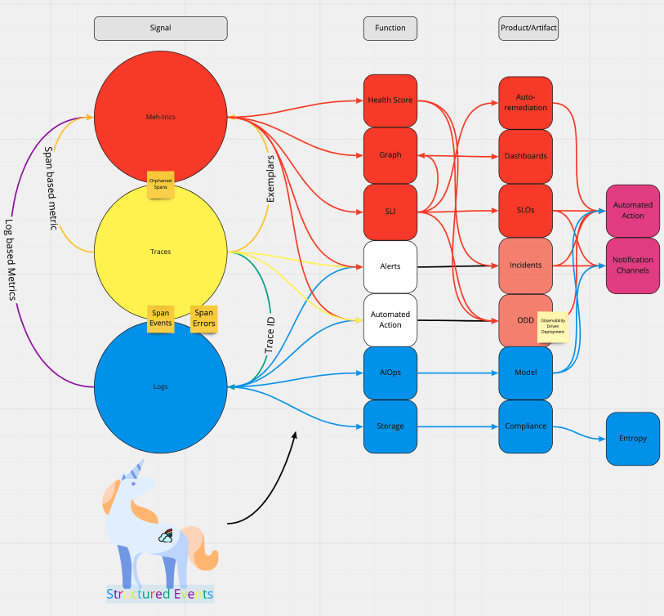
Putting it all together.
The functions and products of observability often rely heavily on metrics
Metrics, traces and logs are the most common signals but Observability in this context is not limited to them.

Slide 26
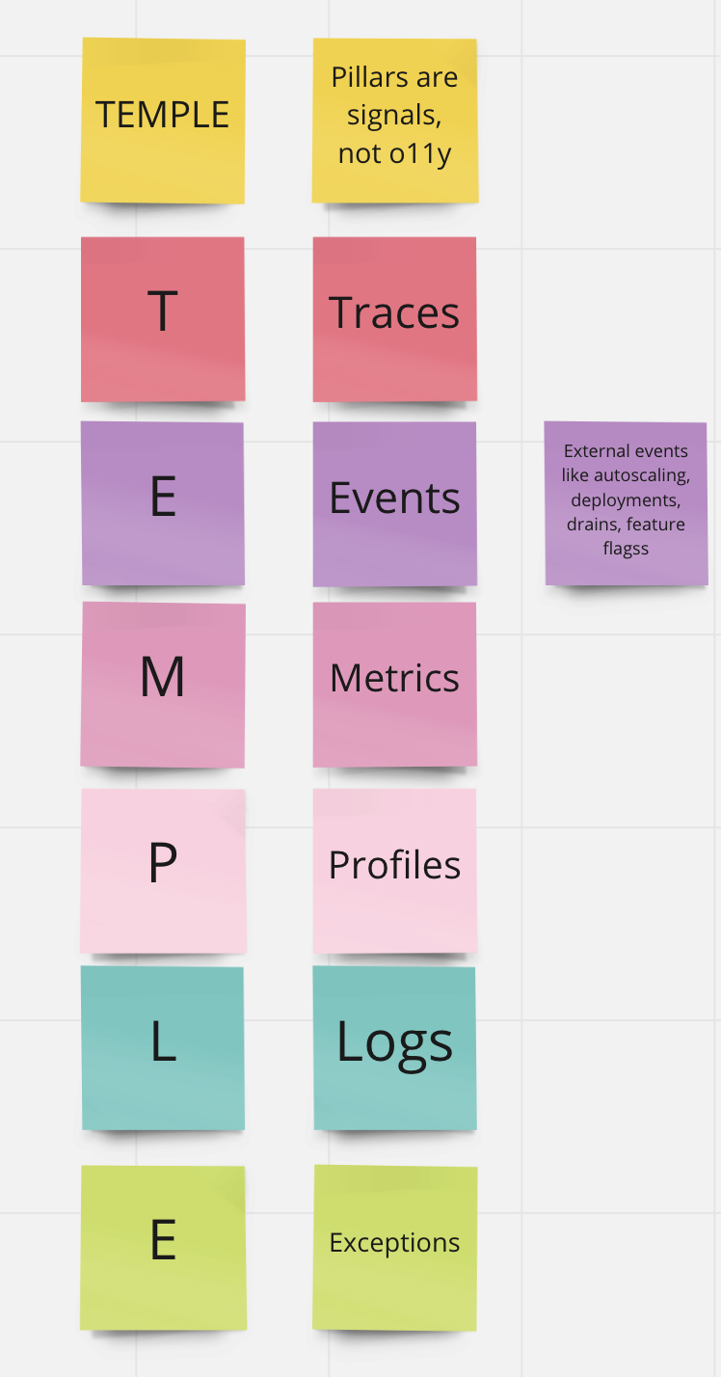
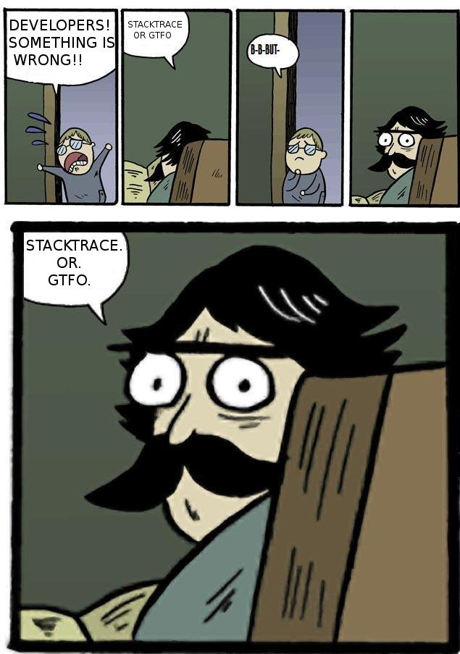
TEMPLE
Continuous Profiling
External Events
Exceptions
eBPF

Slide 27
OpenTelemetry
This changes everything
Open Source CNCF Project
Standard for Telemetry Data
Widely adopted
OTLP Transport Specification

Slide 28
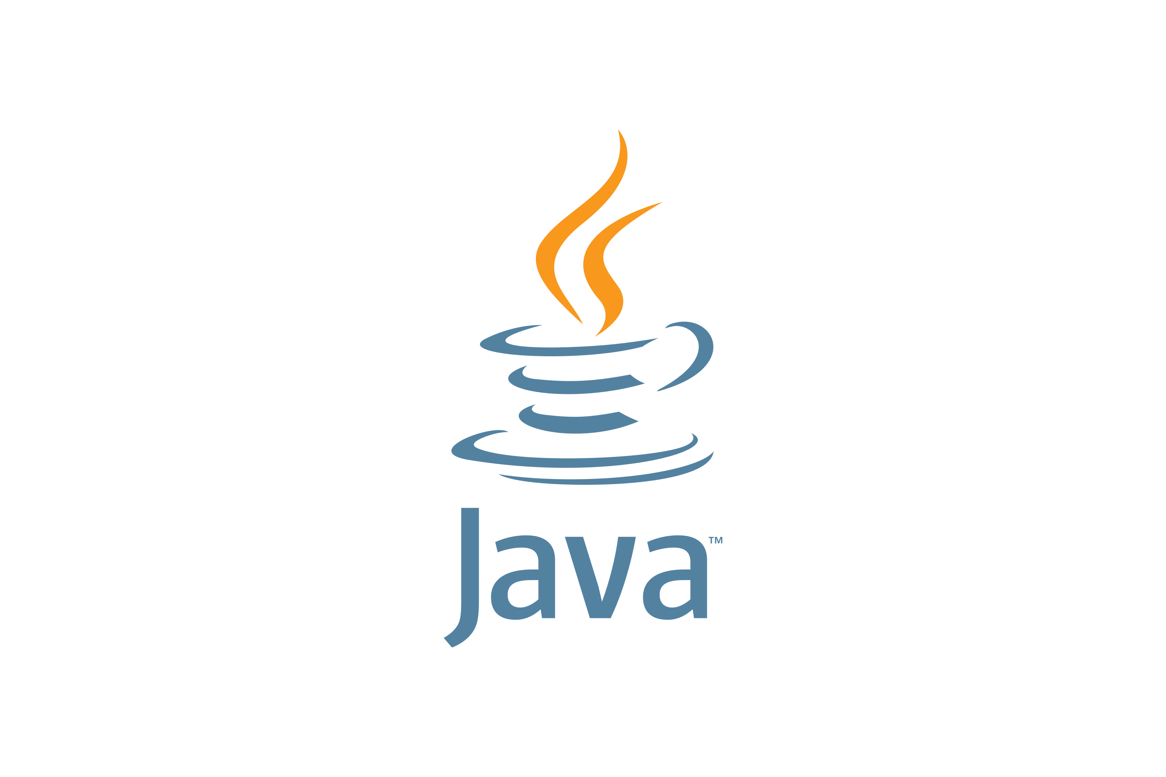
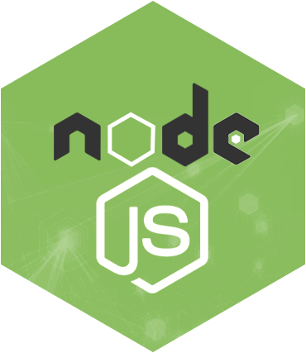
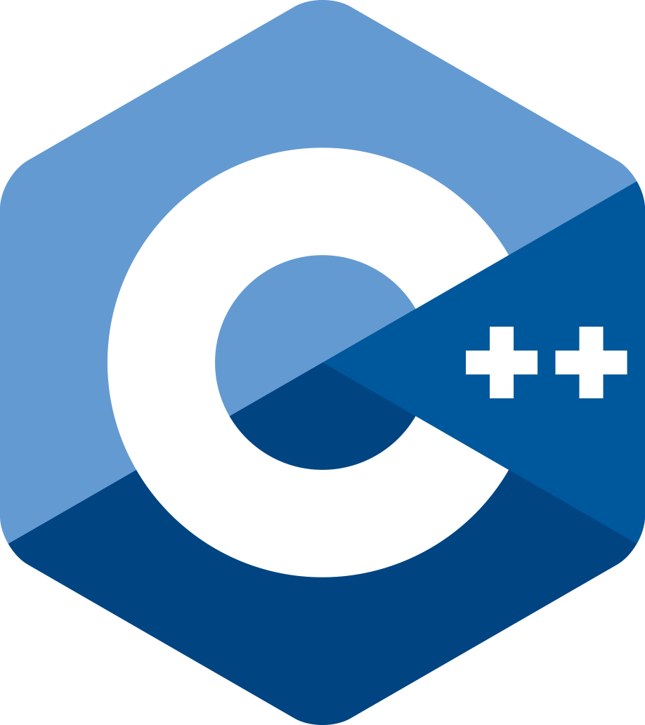
Instrumentation Libraries
Libraries and SDKs available from opentelemetry.io
Kubernetes can auto-inject instrumentation libraries for Java, Python and Node.JS applications.
Automagic Instrumentation

Slide 29
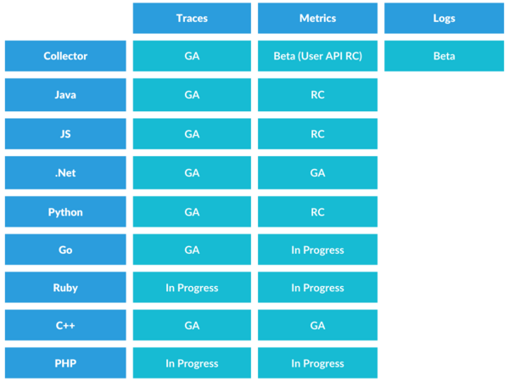
Project Maturity
Current status of metric, log and tracing support in the OpenTelemetry collector and in a number of languages.
*I cannot guarantee this is current.. It's close, though.

Slide 30
OpenTelemetry Collector
Provided by OpenTelemetry Project
Contrib with Vendor Specific Exporters
Collect, Process and Export Telemetry Data
Observability Pipeline Team offers a vendor specific contrib

Slide 31
Role of the OpenTelemetry Collector

Slide 32
Sinks
Where your application sends its telemetry signals.
Examples:
GCP Monitoring
Splunk
Loki
Tempo
Jaeger
Zipkin

Slide 33
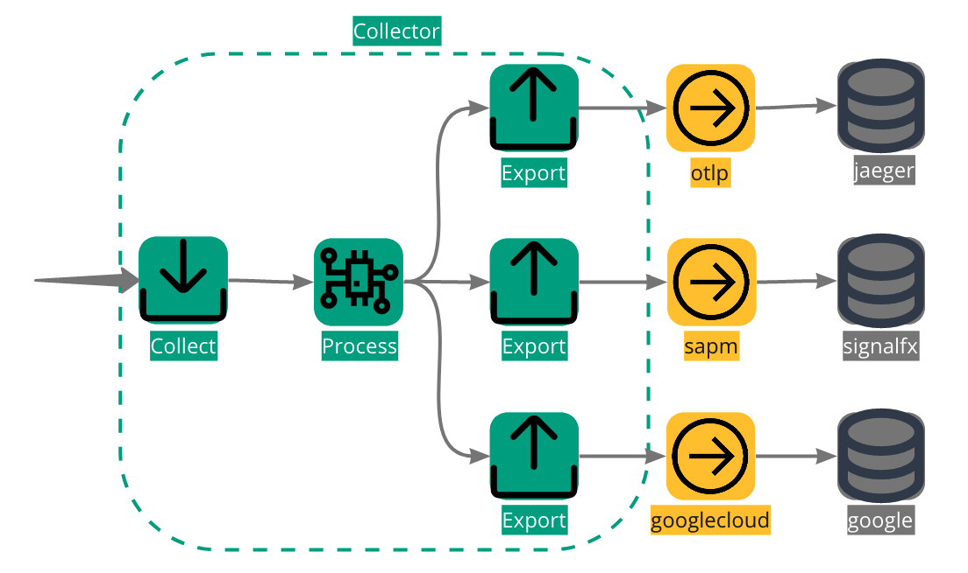
Fan Out
Instrument once and send to one or multiple sinks
Change only the collector configuration to send to a new sink
Multiple supported exporters using the collector contrib.

Slide 34
OpenTelemetry Collector Export Protocols
Native OTLP
Jaeger
Zipkin
Splunk
Pub/Sub

Slide 35
The OpenTelemetry Collector is not a protocol translator
The general idea is that your telemetry is transported via OTLP to a tool/sink and not translated from one contrib protocol to another.

Slide 36
Cloud Agnostic
Instrument once, consume anywhere.
Use the same instrumentation for your application in different environments.
Run the same code in Azure, GCP, AliCloud with the same instrumentation and only change the collector config to suit your needs.

Slide 37
How do we differentiate between Monitoring and Observability?

Slide 38
I will admit to listening to way too much O11ycast.

Slide 39
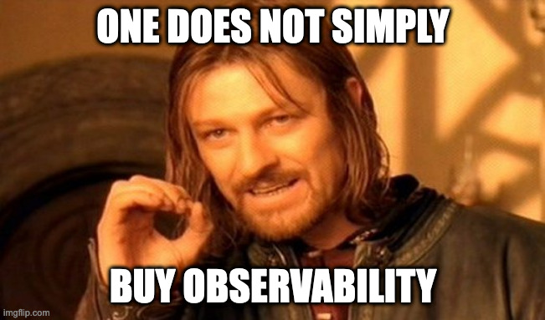
Observability is not the tooling.
Splunk, Google Monitoring, Grafana, and Jaeger are all tools that interpret, process and act upon observability data. Just by sending data to them, you do not have observability.

Slide 40
Observability costs money
It's should be part of any service budget.
It takes time to instrument code.
It should be a NFR of any project.
You can easily defend the cost of your observability data if you are actively using it and getting value from it.

Slide 41
Observability gives value
How are you even sure your application is working as expected if you can't observe it?
If you put the effort into instrumenting your code, you will be rewarded with a deeper understanding of how it is working.

Slide 42
Observability costs money
It's should be part of any service budget.
It takes time to instrument code.
It should be a NFR of any project.
You can easily defend the cost of your observability data if you are actively using it and getting value from it.

Slide 43
Common Challenges in Observability
Write once, read never database
Those "I need ALL the data" people
Dashboards as technical debt
"You build it, you run it" team decides to run own observability stack
"What do you mean this isn't a debugging tool?"
Trying to solve data or business observability issues using only application telemetry.

Slide 44
Site Reliability Engineering
Created by Google
SRE book is freely available

Slide 45
Service Level Agreements Service Level Objectives Service Level Indicators

Slide 46
Where do we even begin?
What metrics can we use to describe the critical aspects of our service?
Where is the best place to measure them?
Who is using this service?
What are our Service Level Indicators?

Slide 47
Metrics: A refresher course in one slide
Delta, Cumulative, Gauge
LETS
Latency
Errors
Traffic
Saturation
SREs Four Golden Signals
USE
Utilization
Saturation
Errors
System-centric
RED
Rate
Error
Duration
Workload-centric

Slide 48
So how is looking at metrics for SLOs different than just monitoring?
We don't want to analyze metrics for every aspect of our service.
We don't need to create a bunch of special rules and tests based on one-off scenarios.
We are only interested in the metrics that make our users happy.
Happy Users Happy Engineers

Slide 49
Where do I start?
How do we go from a few latency and error metrics to SLOs? Metrics are our Service Level Indicators
Specifically chosen and measured at the closest point to the user.

Slide 50
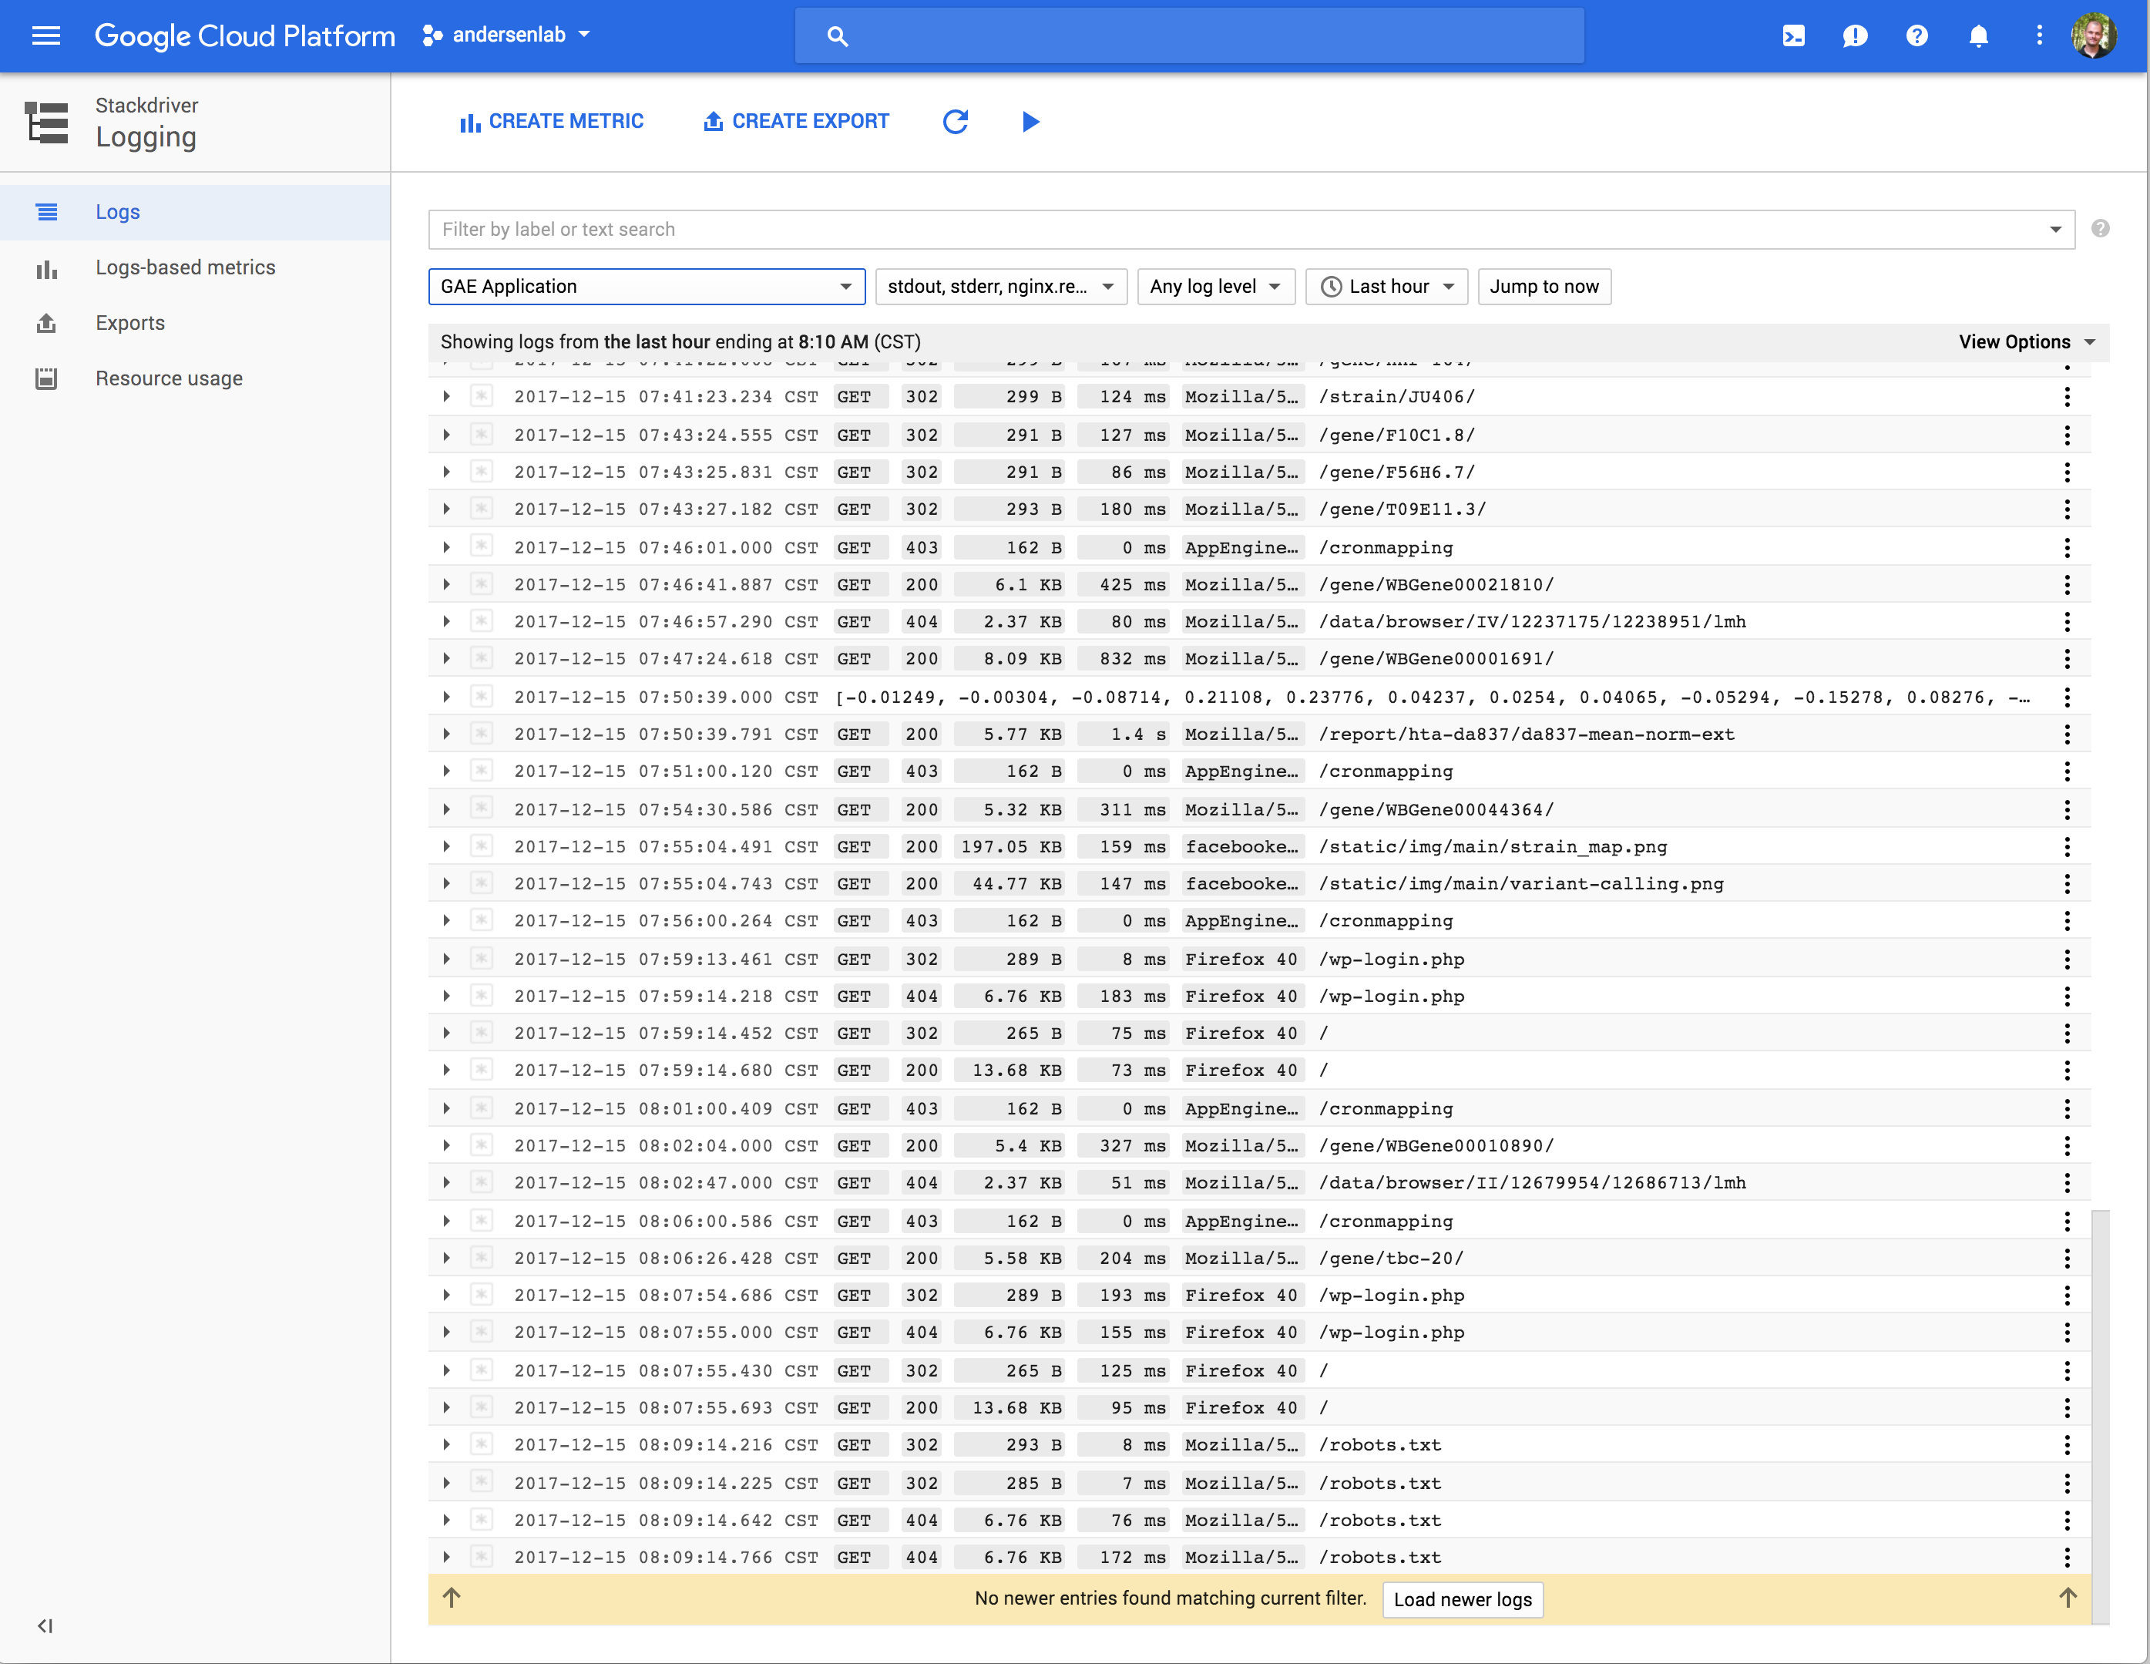
Simplified SLIs
SLI is a measurement of performance.
Good events vs Total Events by Time
200s vs All Http Requests per Month
All events that aren't 500s against all events.
Money spent on compute vs GCP budget per year

Slide 51
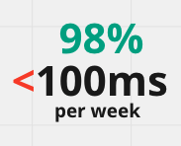
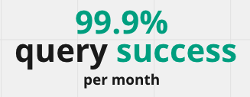
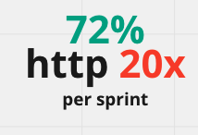
Request based SLIs
Measured counting atomic units of service. Overall performance, but low granularity.

Slide 52
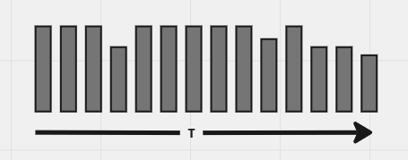
Windows-based SLIs
Group performance by time windows and count good vs bad windows.
95% http 20x responses per 1 minute window
P95 latency metric less than 100ms per 5 minute window

Slide 53
What makes a good SLI?
Metrics:
Delta or Cumulative for Request Based SLI
Delta, Cumulative or Gauge for Windowed SLI
Not high cardinality
Time:
Hours for alerting
Weeks for tactical decisions
Months for strategic decisions
Linear measurement of user happiness. Percentage

Slide 54
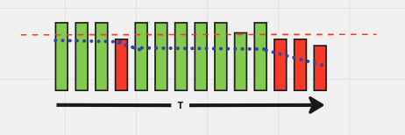
Error Budgets
Maximum amount of time a technical system can fail without contractual consequences.
A measurement of the difference between actual and desired performance.
When are users unhappy, when do people notice.

Slide 55
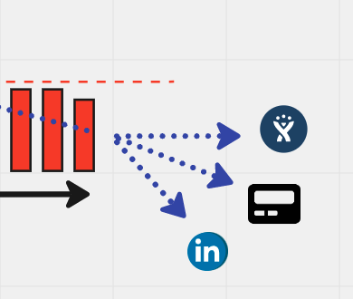
Burn Rate
The rate at which the error budget is consumed.
Make your alerting decisions based on your burn rate.
Clear indication if a problem needs immediate attention, if it can wait until morning or if it needs to be addressed in the next sprint.

Slide 56
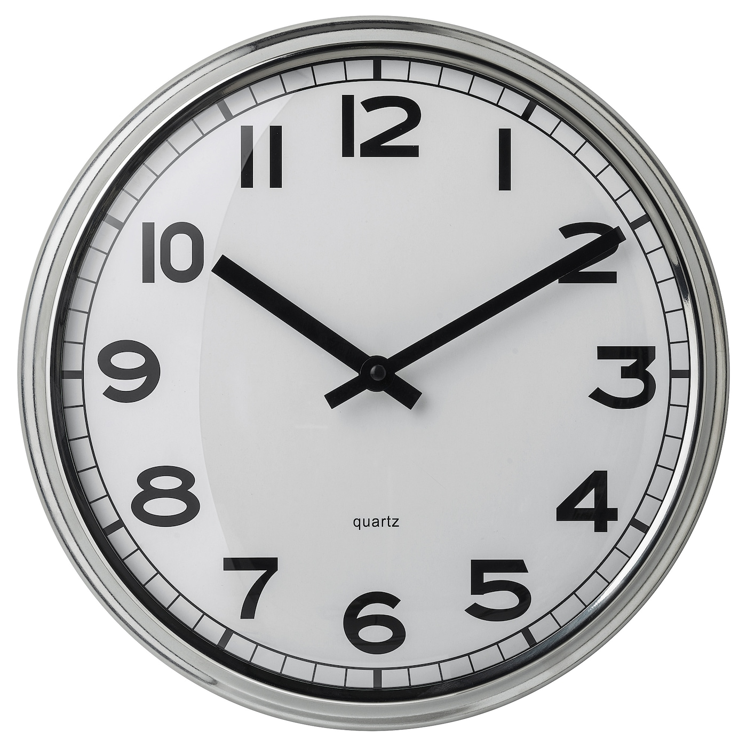
It all comes down to time.
When describing the reliability of a service, the key denominator is time. Requests over time, errors over time, latency over time.

Slide 57
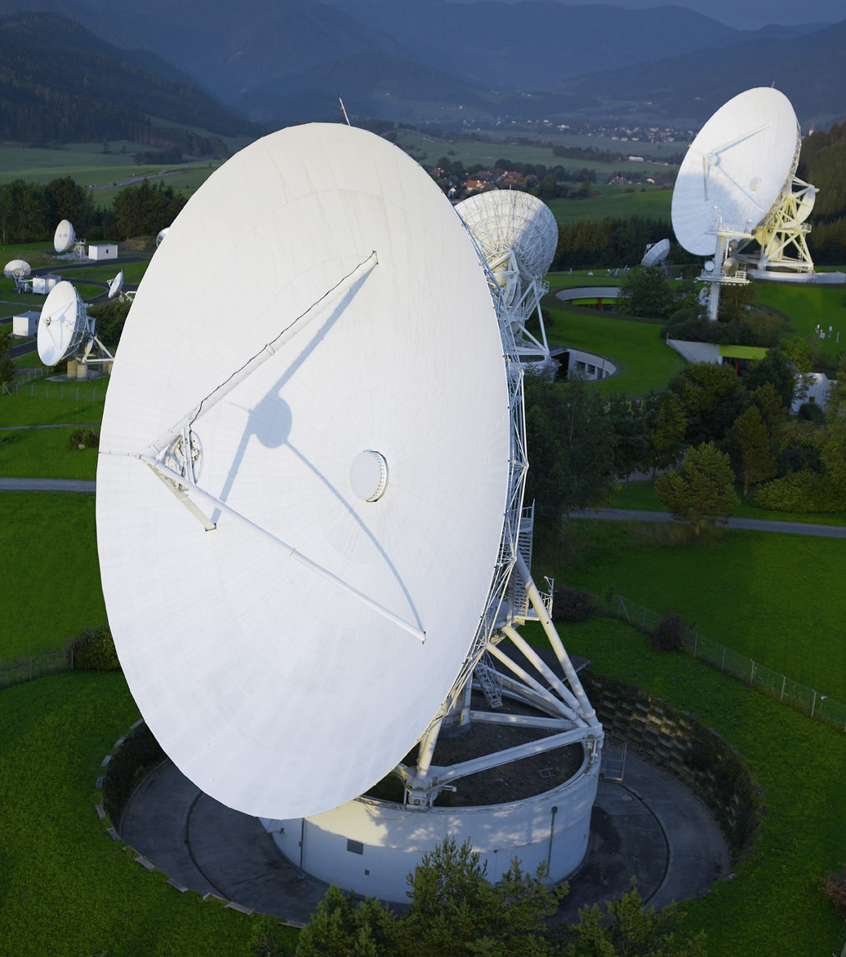
Availability and the mythical nine nines
Available minutes / total minutes
Fundamental layers set the limits of your reliability. You can't have 99.999% reliability on a 99.9% reliable network with a 98% reliable database. The cost of additional nines is exponential.

Slide 58
Appropriate Reliability
What is reasonable for our service?
What timeframe?
How is our service being used?
How many resources are we willing to commit to ensure higher reliability?
Can we get eyes on a problem in time?

Slide 59
Service Level Agreements
The "do not cross" line.
SLA should always be lower than your SLO.
If you don't have an SLA, consider setting SLOs first as a test of what is possible.
Bust your SLA and the fun police get involved.

Slide 60
The role of a SLO
Soft limit
Performance expectation
Not a fixed contract
Meant to be revised, reviewed, updated.
Do you engineer for perfection, or do you set reasonable expectations?

Slide 61
SLOs for Engineers
Do we need to alert the person on call or can this issue wait?
Do we have room in our error budget to deploy a major change?
Did that last deploy change our burn rate?
We blew through our error budget, let's do a blameless post-mortum.

Slide 62
SLOs for Product Owners
Are we living up to our SLAs?
Do we have room to add more features?
Are we making changes that make the consumers happy?

Slide 63
SLOs for Engineering Managers
Do we have the resources to increase our SLA?
Are we meeting our SLO goals?
Do we focus on developing new features or increasing reliability?
Are we burning up on-call time for non-critical issues?
Do we focus on features or stability in the next sprint?

Slide 64
SLOs in the wild
Share your SLIs and SLOs to create a reasonable expectation of service level for your consumers.
Choose a synchronous or asynchronous means of sending data to an API based on latency and peak request SLIs.
Communicate service issues to stakeholders.
Allow teams to understand service issues without having deep technical knowledge of your service or share all your telemetry.

Slide 65
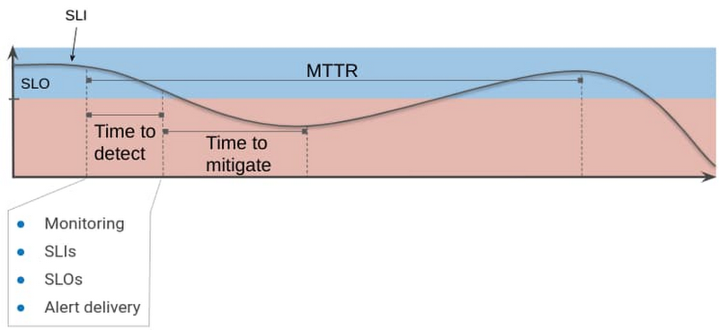
But my service is feature driven...
SLO can be thought of as acceptable level of risk.
SLOs can be an integral part of your DORA metrics.

Slide 66
Is it good enough?

Slide 67
Comparing SLOs to ITSI

Slide 68
Philosophical Differences
Free vs Proprietary
Decentralized vs Centralized
Clear boundaries between business and operational data
Tool agnostic vs Splunk specific
Integral component driving discussion between engineers, EM and PO

Slide 69
Design Differences
Measure as close as possible to consumer vs weighted service decomp
SLO data can be collected by APIs*
Burn Rates vs Adaptive Thresholds
SLIs vs KPIs
Metrics consumed where they are produced vs single source of truth
DORA metrics vs Event Analytics
Tracing as an automagic service map

Slide 70
Thoughts?
Are you adopting SRE?
Is anyone mixing SRE and ITSI in production?
Would SLI or SLO data scraped from Prometheus and API or a Time-Series database be of any use as a KPI in ITSI?
Is anyone using trace propagation data to create service maps in Splunk?

Slide 72
Find out more here:
https://monitoring.love/community/
https://communityinviter.com/apps/cloud-native/cncf
https://opentelemetry.io
https://info.honeycomb.io/observability-engineering-oreilly-book-2022
https://www.heavybit.com/library/podcasts/o11ycast
https://sre.google
https://medium.com/@YuriShkuro/temple-six-pillars-of-observability-4ac3e3deb402

Slide 73
Thanks!

